Slide 1

Virtual Machine
Computer System Engineering, Fall 2019. (IPADS, SJTU)
Virtualizing CPU, memory and devices
Yubin Xia

Slide 2
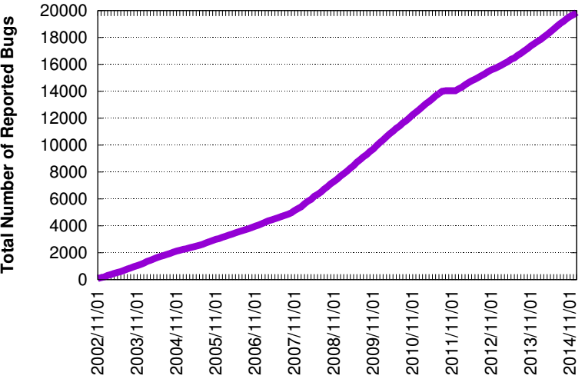
Review: Linux Bugs
Source: Bugzilla.kernel.com, count of all bugs currently marked NEW, ASSIGNED, REOPENED, RESOLVED, VERIFIED, or CLOSED, by creation data

Slide 3
Virtual Machine

Slide 4
Run multiple Linux on a Single Computer?
Virtualization + Abstractions
New constraint: compatibility, because we want to run existing Linux kernel
Linux kernel written to run on regular hardware
No abstractions, pure virtualization
Approach is called "virtual machines" (VM):
Each virtual machine is often called a guest
The equivalent of a kernel is called a "virtual machine monitor" (VMM)
The VMM is often called the host

Slide 5
Why Virtual Machine?
Consolidation
Run several different OS on a single machine
Isolation
Keep the VMs separated as error container
Fault tolerant
Maintenance
Easy to deploy, backup, clone, migrate
Security
VM introspection
Antivirus out of the OS

Slide 6
What are the Differences between OS & VMM?
Similarities
Multiplex hardware
Higher privilege
Differences
Different abstraction
VMM schedules VMs, OS schedules processes
App-1
App-2
App-3
VM-1
VM-2
VM-3
OS
VMM
CPU
Mem
Device
CPU
Mem
Device

Slide 7
Virtualization
CPU virtualization
Enable each guest VM has its own kernel and user modes
Keep isolation between guest's kernel and user modes
Memory virtualization
Enable each guest VM has its own virtual MMU
Keep isolation between guest VMs
I/O virtualization
Enable each guest VM has its own virtual devices

Slide 8
CPU Virtualization

Slide 9
CPU Virtualization: Process and VM
Each process thinks it has the entire CPU
Does not care other processes
OS schedules the processes
OS splits the CPU time to time-slices
Schedule each process preemptively
3 phases: save context, find next, restore context
Idea: Why not run a VM as a process?

Slide 10
First Try: OS on OS
Run as an application!
Guest VM
Guest OS
Guest App-1
Guest App-2
Host App-1
Host App-2
User mode
Kernel mode
Host OS
(Now works as VMM)
CPU
Mem
Device

Slide 11
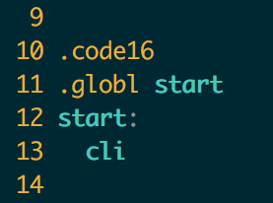
Run OS as an Application
Stuck at the very first instruction
cli : disable interrupt
It's a privilege instruction
Cannot run in user mode!
Similar instructions
E.g., change CR3, set IDT, etc.
These instructions will change machine states
xv6: bootasm.S

Slide 12
Challenges of Privilege Instruction
Guest OS-1
Guest OS-2
Guest OS-3
Guest OS-4
Mov $100, CR3
Mov $80, CR3
Mov $120, CR3
Mov $200, CR3
Host OS
CPU
Mem
Device
Guest OS executes privilege instructions
Guest OS are not allowed to run the privilege instructions

Slide 13
Solution: Trap & Emulate
Trap: running privilege instructions in user-mode will trap to the VMM
Emulate: those instructions are implemented as functions in the VMM
System states are kept in VMM's memory, and are changed according
Guest OS-1
Guest OS-2
Guest OS-3
Trap
Mov $100, CR3
Host OS
Emulate
Emulate
Mov $20, CR3
CPU
Mem
Device

Slide 14
Now We Can Run OS as an Application
Host OS virtualizes system states
Save guest system states in memory
When a guest OS runs cli
CPU will trap to the host OS (trap)
Host OS will change the IF bit (emulate)
How does a host OS deliver interrupt to a guest OS?
Similar as delivering a signal to an application
Problem solved? No...
xv6: bootasm.S

Slide 15
Problems of Trap & Emulate
Not all architectures are "strictly virtualizable"
An ISA is strictly virtualizable if, when executed in a lesser privileged mode:
All instructions that access privileged state trap
All instructions either trap or execute identically
Trap costs may be high

Slide 16
X86 is not Strictly Virtualizable
Example: the popf instruction
popf takes a word off the stack and puts in into the flags register
One flag in that register is the interrupt enable flag (IF)
At system level the IF flag is updated by popf
At user level the IF flag is not updated, and CPU silently drops updates to the IF
There 17 such instructions in X86
SGDT, SIDT, SLDT, SMSW, PUSHF, POPF, LAR, LSL, VERR, VERW, POP, PUSH, CALL, JMP, INT n, RET, STR, MOV

Slide 17
How to Deal with the 17 Instructions?
Instruction Interpretation: emulate them by software
Binary translation: translate them to other instructions
Para-virtualization: replace them in the source code
New hardware: change the CPU

Slide 18
Sol-1: Instruction Interpretation
Emulate Fetch/Decode/Execute pipeline in software
Emulate all the system status using memory
E.g., using an array GPR[8] for general purpose registers
None guest instruction executes directly on hardware
E.g., Bochs

Slide 19
Example: Virtualizing Interrupt Flag w/ Instruction Interpreter
void CPU_Run(void)
{
while (1) {
inst = Fetch(CPUState.PC);
CPUState.PC += 4;
switch (inst) {
case ADD:
CPUState.GPR[rd] = GPR[rn] + GPR[rm];
break;
…
case CLI:
CPU_CLI(); break;
case STI:
CPU_STI(); break;
}
if (CPUState.IRQ && CPUState.IE) {
CPUState.IE = 0;
CPU_Vector(EXC_INT);
}
}
}
void CPU_CLI(void)
{
CPUState.IE = 0;
}
void CPU_STI(void)
{
CPUState.IE = 1;
}
void CPU_Vector(int exc)
{
CPUState.LR = CPUState.PC;
CPUState.PC = disTab[exc];
}

Slide 20
Instruction Interpretation
Positives
Easy to implement & minimal complexity
Negatives
Very slow!

Slide 21
Sol-2: Binary Translator
Translate before execution
Translation unit is basic block (why?)
Each basic block -> code cache
Translate the 17 instructions to function calls
Implemented by the VMM
E.g., VMware, Qemu

Slide 22
Architecture of a Binary Translator
Guest
Code
Translator
TC
Index
Translation
Cache
CPU Emulation
Routines
Callouts

Slide 23
Basic Blocks
Guest Code
vPC
mov ebx, eax
cli
and ebx, ~0xfff
Straight-line code
Basic Block
mov ebx, cr3
sti
ret
Control flow

Slide 24
Binary Translation
Guest Code
Translation Cache
vPC
mov ebx, eax
mov ebx, eax
start
cli
call HANDLE_CLI
and ebx, ~0xfff
and ebx, ~0xfff
mov ebx, cr3
mov [CO_ARG], ebx
sti
call HANDLE_CR3
ret
call HANDLE_STI
jmp HANDLE_RET
Notes:
Dynamic binary translation is used in virtualizing the CPU by translating potentially dangerous (or non-virtualizable) instruction sequences one-by-one into safe instruction sequences.
It works like this:
The monitor inspects the next sequence of instructions. An instruction sequence is typically defined as the next basic block, that is all instructions up to the next control transfer instruction such as a branch. There may be reasons to end a sequence earlier or go past a branch but for now lets assume we go to the next branch.
Each instruction is translated and the translation is copied into a translation cache.
Instructions are translated as follows:
Instructions which pose no problems can be copied into the translation cache with modification. We call these "ident" translations.
Some simple dangerous instructions can be translated into a short sequence emulation code. This code is placed directly into the translation cache. We call this "inline" translation. An example is the modification of the Interrupt Enable flag.
Other dangerous instructions need be performed by emulation code in the monitor. For these instructions calls to the monitor are made. These are called "Call-outs". An example of these is a change to the page table base.
The branch ending the basic block needs a call out.
The monitor can now jump to the start of the translated basic block with the virtual registers in the hardware registers.
So dangerous instructions can be privileged instructions, non-virtualizable instructions, control flow, memory accesses.

Slide 25
Binary Translation
Guest Code
Translation Cache
vPC
mov ebx, eax
mov ebx, eax
start
cli
mov [CPU_IE], 0
and ebx, ~0xfff
and ebx, ~0xfff
mov ebx, cr3
mov [CO_ARG], ebx
sti
call HANDLE_CR3
ret
mov [CPU_IE], 1
test [CPU_IRQ], 1
jne
call HANDLE_INTS
jmp HANDLE_RET
Notes:
Dynamic binary translation is used in virtualizing the CPU by translating potentially dangerous (or non-virtualizable) instruction sequences one-by-one into safe instruction sequences.
It works like this:
The monitor inspects the next sequence of instructions. An instruction sequence is typically defined as the next basic block, that is all instructions up to the next control transfer instruction such as a branch. There may be reasons to end a sequence earlier or go past a branch but for now lets assume we go to the next branch.
Each instruction is translated and the translation is copied into a translation cache.
Instructions are translated as follows:
Instructions which pose no problems can be copied into the translation cache with modification. We call these "ident" translations.
Some simple dangerous instructions can be translated into a short sequence emulation code. This code is placed directly into the translation cache. We call this "inline" translation. An example is the modification of the Interrupt Enable flag.
Other dangerous instructions need be performed by emulation code in the monitor. For these instructions calls to the monitor are made. These are called "Call-outs". An example of these is a change to the page table base.
The branch ending the basic block needs a call out.
The monitor can now jump to the start of the translated basic block with the virtual registers in the hardware registers.
So dangerous instructions can be privileged instructions, non-virtualizable instructions, control flow, memory accesses.

Slide 26
Basic Binary Translator
void BT_Run(void)
{
CPUState.PC = _start;
BT_Continue();
}
void BT_Continue(void)
{
void *tcpc;
tcpc = BTFindBB(CPUState.PC);
if (!tcpc) {
tcpc = BTTranslate(CPUState.PC);
}
RestoreRegsAndJump(tcpc);
}
void *BTTranslate(uint32 pc)
{
void *start = TCTop;
uint32 TCPC = pc;
while (1) {
inst = Fetch(TCPC);
TCPC += 4;
if (IsPrivileged(inst)) {
EmitCallout();
} else if (IsControlFlow(inst)) {
EmitEndBB();
break;
} else {
/* ident translation */
EmitInst(inst);
}
}
return start;
}

Slide 27
Basic Binary Translator
void BT_CalloutSTI (BTSavedRegs regs)
{
CPUState.PC = BTFindPC(regs.tcpc);
CPUState.GPR[] = regs.GPR[];
CPU_STI();
CPUState.PC += 4;
if (CPUState.IRQ
&& CPUState.IE) {
CPUVector();
BT_Continue();
/* NOT_REACHED */
}
return;
}

Slide 28
Issues with Binary Translation
PC synchronization on interrupts
Now interrupt will only happen at basic block boundary
But on real machine, interrupt may happen at any instruction
Carefully handle self-modifying code (SMC)
Notified on writes to translated guest code

Slide 29
Hybrid Approach
DirectExec
OK?
Yes
Direct Execution
Jump to Guest PC
Trap
Handle
Priv.
Instruction
No
TC
Validate
Execute
In TC
Callout
Binary translation for the kernel
Direct execution (trap & emulate) for the applications

Slide 30
Sol-3: Para-virtualization
Modify OS and let it cooperate with the VMM
Change sensitive instructions to calls to the VMM
Also known as hypercall
Hypercall can be seen as trap
E.g., Xen hypervisor
Host 100 VMs on 1 machine

Slide 31
Sol-4: Hardware Supported CPU Virtualization
VMX root operation:
Full privileged, intended for Virtual Machine Monitor
VMX non-root operation:
Not fully privileged, intended for guest software
Both forms of operation support all four privilege levels from 0 to 3
app
app
Non-Root / Ring-3
app
app
Root / Ring-3
Guest kernel
Non-Root / Ring-0
VMEnter
VMExit
Root / Ring-0
Host Kernel (VMM)

Slide 32
Memory Virtualization

Slide 33
Virtualizing the Page Tables
Terminology: 3 types of address now
GVA->GPA->HPA (Guest virtual. Guest physical. Host physical)
Guest VM's page table contains GPA
Setting CR3 to point to guest page table would not work
E.g., a processes in VM might access host physical address 0~1GB, which might not belong to that guest VM
Solution-1: shadow paging
Solution-2: direct paging
Solution-3: new hardware

Slide 34
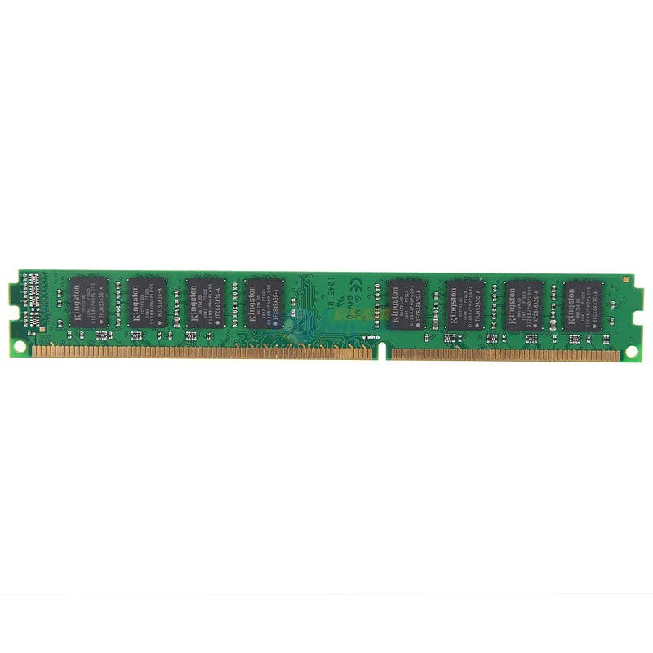
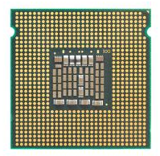
Solution-1: Shadow Pages
Guest VM
GVA
GVA
GPT
GPA
GPA
HPT
SPT
HPA
HPA
CR3

Slide 35
Two Page Tables Become One
VMM intercepts guest OS setting the virtual CR3
VMM iterates over the guest page table, constructs a corresponding shadow page table
In shadow PT, every guest physical address is translated into host physical address
Finally, VMM loads the host physical address of the shadow page table

Slide 36
Setup Shadow Page Table
set_cr3 (guest_page_table):
for GVA in 0 to 220
if guest_page_table[GVA] & PTE_P:
GPA = guest_page_table[GVA] >> 12
HPA = host_page_table[GPA] >> 12
shadow_page_table[GVA] = (HPA<<12)|PTE_P
else
shadow_page_table = 0
CR3 = PHYSICAL_ADDR(shadow_page_table)

Slide 37
Question
Assume that:
There are 10 VMs running on a machine
Each VM contains 10 applications
Q: how many shadow page tables in total?
Shadow page tables are per application
Guest page tables are per application
Host page tables are per VM

Slide 38
What if a Guest OS Modifies its Own Page Table?
It will have no effect!
Since CR3 is now pointing to the shadow page table
Need to synchronize the shadow page table with guest page table
Solution
VMM need to intercept when guest OS modifies page table, and update the shadow page table accordingly
Mark the guest table pages as read-only (in the shadow page table)
If guest OS tries to modify its page tables, it triggers page fault
VMM handles the page fault by updating shadow page table

Slide 39
What if a Guest App Access its Kernel Memory?
Remember that now the kernel is running in user mode
It means any application may also access guest kernel's memory
How do we selectively allow / deny access to kernel-only pages?
One solution: split a shadow page table to two tables
Two shadow page tables, one for user, one for kernel
When guest OS switches to user mode, VMM will switch the shadow page table as well, vice versa
Recall trap & emulate

Slide 40
Two Memory Views of Guest VM
When guest OS
is running
When application
is running
Kernel space
No user access
User space
User access

Slide 41
The Same Question
Assume that:
There are 10 VMs running on a machine
Each VM contains 10 applications
Q: now, how many shadow page tables in total?

Slide 42
Sol-2: Direct Paging (Para-virtualization)
Modify the guest OS
No GPA is needed, just GVA and HPA
Guest OS directly manages its HPA space
Use hypercall to let the VMM update the page table
The hardware CR3 will point to guest page table
VMM will check all the page table operations
The guest page tables are read-only to the guest

Slide 43
Sol-2: Direct Paging (Para-virtualization)
Positive
Easy to implement and more clear architecture
Better performance: guest can batch to reduce trap
Negatives
Not transparent to the guest OS
The guest now knows much info, e.g., HPA
May use such info to trigger rowhammer attacks

Slide 44
Sol-3: Hardware Supported Memory Virtualization
Hardware implementation
Intel's EPT (Extended Page Table)
AMD's NPT (Nested Page Table)
Another table
EPT for translation from GPA to HPA
EPT is controlled by the hypervisor
EPT is per-VM

Slide 45
Guest VM
VMM
GVA
PT
GPA
VA
EPT
PT
HPA
PA
Non-root mode
Root mode

Slide 46
More on Virtualization
I/O virtualization
Sol-1: Device emulation
Sol-2: Para-virtualization driver, e.g., virtio
Sol-3: Hardware support, e.g., SR-IOV
Will be discussed in the OS lecture

